Slide 2
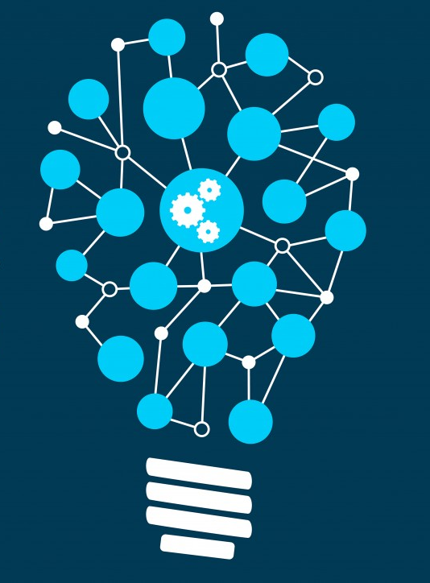
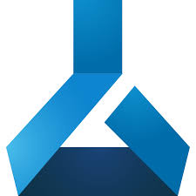
Azure Machine Learning
Shiva Chittamuru
Cloud Solution Architect
This Photo by Unknown Author is licensed under CC BY-SA

Slide 3
AI represents a growing opportunity
$
3.9
T
Decision support
Global business value derived from AI in 2022 will reach
Decision automation
$
3.9
T
Smart products
Virtual agents
“Forecast: The Business Value of Artificial Intelligence, Worldwide, 2017–2025”, Gartner, April 2018.
Notes:
Gartner predicts that, in 2022, the global business value derived from AI will be $3.9 trillion.
Decision support and augmentation will account for $1.7T.
Virtual agents will account for $1T.
Smart products will account for $624B.
Decision automation systems will account for $546B.
<Transition>: $3.9T. Let’s break that down.

Slide 4
Adopting AI in your company
Where do you see your company today?
Where do you see your top competitors today?
Where do you see your company in the future?
Analytics capabilities
BASIC
ADVANCED
Notes:
We’d like to understand where you see your business in terms of adopting advanced analytics and where you would like to be in the future.
Where do you see your company today?
Where do you see your company in the future?
Where do you see your top competitors today?
<Transition>: We conducted an independent research study where we talked with our customers about these exact three questions.

Slide 5
What are companies looking to do next?
Deep neural networks will be a standard tool for 80% of data scientists¹
20% of companies will dedicate workers to monitor neural networks¹
30% of net new revenue growth from industry-specific solutions will include AI¹
2018
2019
2020
2021
2022
90% of modern analytics platforms will feature natural-language generation¹
More than 40% of data science tasks will be automated¹
1 in 5 workers engaged in mostly nonroutine tasks will rely on AI to do their jobs²
1 “100 Data and Analytics Predictions Through 2021”, Gartner, 2017.
2 “Predicts 2018: AI and the Future of Work”, Gartner, 2018.
Notes:
Companies who have been successful with machine learning are now looking to expand their work further into deep learning. I want to give you a sense for what the future looks like for organizations implementing advanced analytics.
In 2018, deep neural networks will be a standard tool for 80% of data scientists’ tool boxes.
By 2019, natural-language generation will be a standard feature of 90% of modern BI and analytics platforms.
By 2020, 20% of companies will dedicate workers to monitor and guide neural networks.
Also by 2020, more than 40% of data science tasks will be automated, resulting in increased productivity and broader usage by citizen data scientists.
By 2021, 30% of net new revenue growth from industry-specific solutions will include AI.
By 2022, 1 in 5 workers engaged in mostly non-routine tasks will rely on AI to do their jobs.
<Transition>: The next generation of advanced analytics success will be powered by deep learning.

Slide 6
Microsoft Azure has a comprehensive portfolio for AI

Slide 7
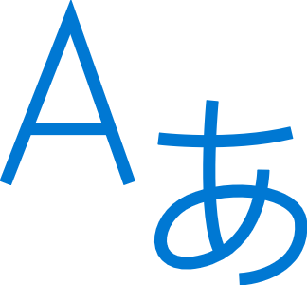





Machine Learning on Azure
Domain specific pretrained models
To simplify solution development
…
Vision
Speech
Language
Search
Familiar data science tools
To simplify model development
Visual Studio Code
Azure Notebooks
Jupyter
Command line
Popular frameworks
To build advanced deep learning solutions
PyTorch
TensorFlow
Scikit-Learn
ONNX
Productive services
To empower data science and development teams
Azure Databricks
Azure Machine Learning
Azure Synapse
Powerful infrastructure
To accelerate deep learning
CPU
GPU
FPGA
From the Intelligent Cloud to the Intelligent Edge
Notes:
The way we think about ML on Azure is very simple – we break it into what customers want for their ML solutions. There are 5 key asks
Talk about pre-trained models here, as no special slide for that
- For the rest of the stack, it comprises of everything needed for Data Scientists.

Slide 8

Machine Learning on Azure
Domain specific pretrained models
To simplify solution development
…
Vision
Speech
Language
Search
Familiar data science tools
To simplify model development
Visual Studio Code
Azure Notebooks
Jupyter
Command line
Popular frameworks
To build advanced deep learning solutions
PyTorch
TensorFlow
Scikit-Learn
ONNX
Productive services
To empower data science and development teams
Azure Databricks
Azure Machine Learning
Machine Learning VMs
Powerful infrastructure
To accelerate deep learning
CPU
GPU
FPGA
From the Intelligent Cloud to the Intelligent Edge
Notes:
First thing we need is - Tools

Slide 9
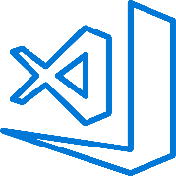


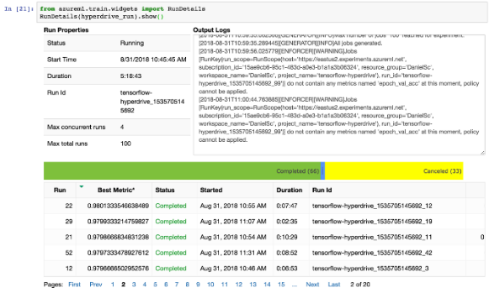
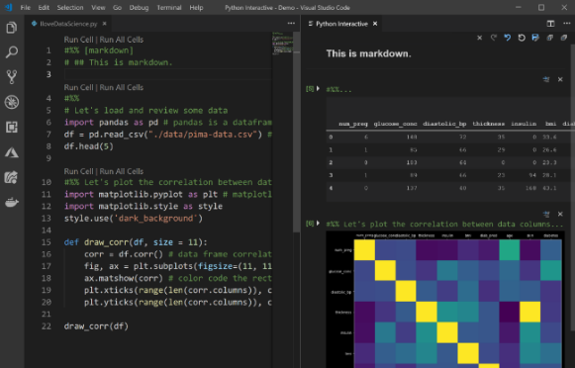
Familiar data science tools
Choose any python development environment
Visual Studio Code
Azure Notebooks
Jupyter
PyCharm
Zeppelin
Command line
And improve data science productivity
Interactive widgets for Jupyter Notebooks
Azure Machine Learning for Visual Studio Code extension
Get started with AML on Azure Notebooks: http://aka.ms/aznotebooks-aml
Notes:
Put a link to Azure Notebooks samples
https://aka.ms/aznotebooks-aml
Azure ML provides the flexibility for customers to bring their tool of choice.
Don’t need to change your habits, no uncomfortable unlearning/re-learning
We also provide widgets and extension for tools to make them more efficient to use for ML

Slide 10
Machine Learning on Azure
Domain specific pretrained models
To simplify solution development
…
Vision
Speech
Language
Search
Familiar data science tools
To simplify model development
Visual Studio Code
Azure Notebooks
Jupyter
Command line
Popular frameworks
To build advanced deep learning solutions
PyTorch
TensorFlow
Scikit-Learn
ONNX
Productive services
To empower data science and development teams
Azure Databricks
Azure Machine Learning
Machine Learning VMs
Powerful infrastructure
To accelerate deep learning
CPU
GPU
FPGA
From the Intelligent Cloud to the Intelligent Edge
Notes:
That’s where frameworks come into our rescue.
We’re not first building such a model – someone has done these before
We can learn from their experience and use best practices
Deep learning frameworks offer building blocks for designing, training and validating deep neural networks, through a high level programming interface

Slide 11







Powerful frameworks Build advanced deep learning solutions
Use your favorite deep learning frameworks
without getting locked into one framework
TensorFlow
PyTorch
Scikit-Learn
ONNX
Community project created by Facebook and Microsoft
Use the best tool for the job. Train in one framework and transfer to another for inference
MXNet
Chainer
Keras
Notes:
Our approach to ML frameworks is simple.
We give customers the flexibility to choose their deep learning framework, without getting locked one framework.
To help with this we’ve created a community project in partnership with Facebook that allows customers to train in one framework and use another one for inference

Slide 12











ONNX is the new open ecosystem for AI models
Create
Deploy
Frameworks
Azure
Azure Machine Learning services
Ubuntu VM
Windows Server 2019 VM
ONNX Model
Devices
Services
Windows devices
Azure Custom Vision Service
Other devices (iOS, etc.)
Notes:
Custom vision

Slide 13
Machine Learning on Azure
Domain specific pretrained models
To simplify solution development
…
Vision
Speech
Language
Search
Familiar data science tools
To simplify model development
Visual Studio Code
Azure Notebooks
Jupyter
Command line
Popular frameworks
To build advanced deep learning solutions
PyTorch
TensorFlow
Scikit-Learn
ONNX
Productive services
To empower data science and development teams
Azure Databricks
Azure Machine Learning
Azure Synapse
Powerful infrastructure
To accelerate deep learning
CPU
GPU
FPGA
From the Intelligent Cloud to the Intelligent Edge
Notes:
Now that you have these frameworks to make your life easy, you want to get started
But there are more challenges
How do I access resources
Where do I get the dependencies
How do I keep track
What if I need to execute in parallel
Where’s CI/CD
This is where productive services help

Slide 14

Azure Machine Learning

Slide 15


Azure Machine Learning
For all skill levels
Industry leading MLOps
Open & Interoperable
Trusted
Notes:
Balance slide – 3 pillars – why most compelling – FIX IMAGE/SLIDE
Productivity – automated ML, user GUI
E2e – ML ops,
Open plat – ONNX runtime MLFlow

Slide 16
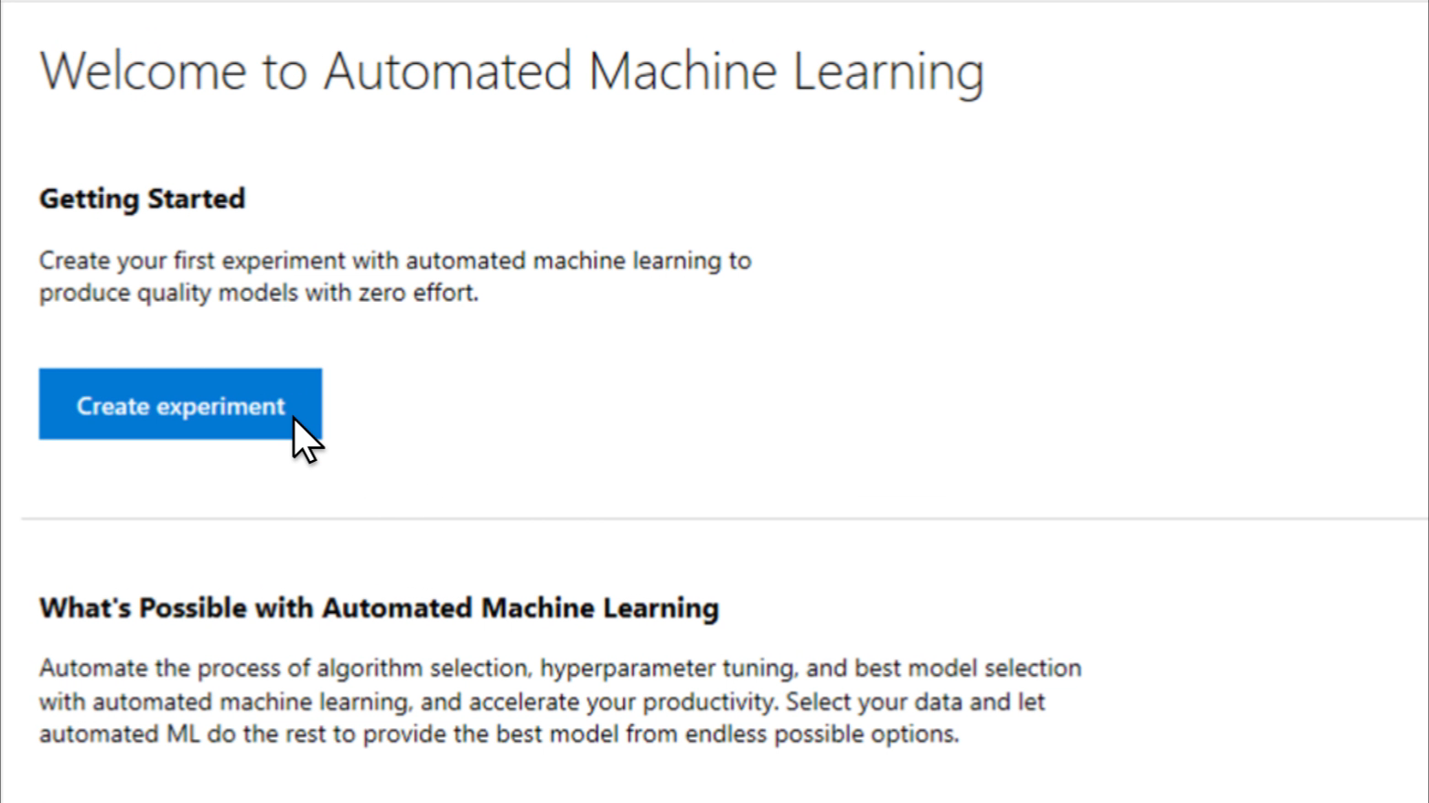
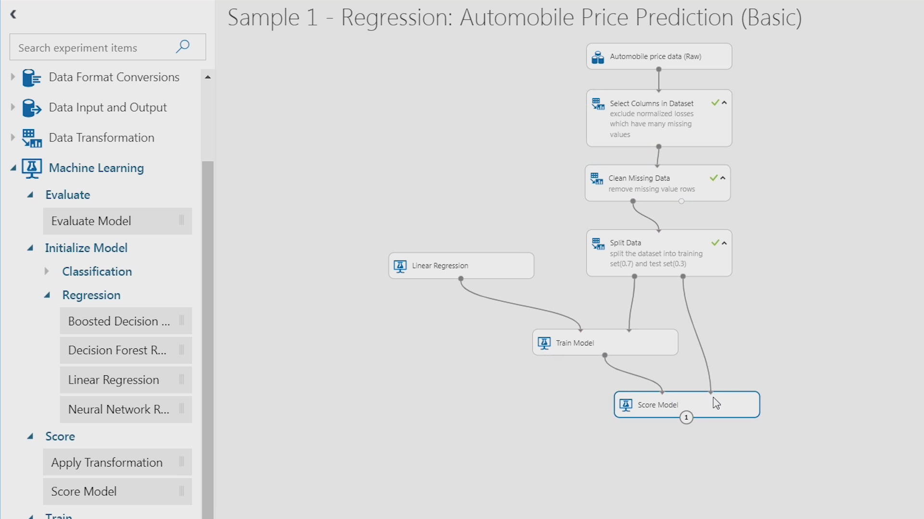
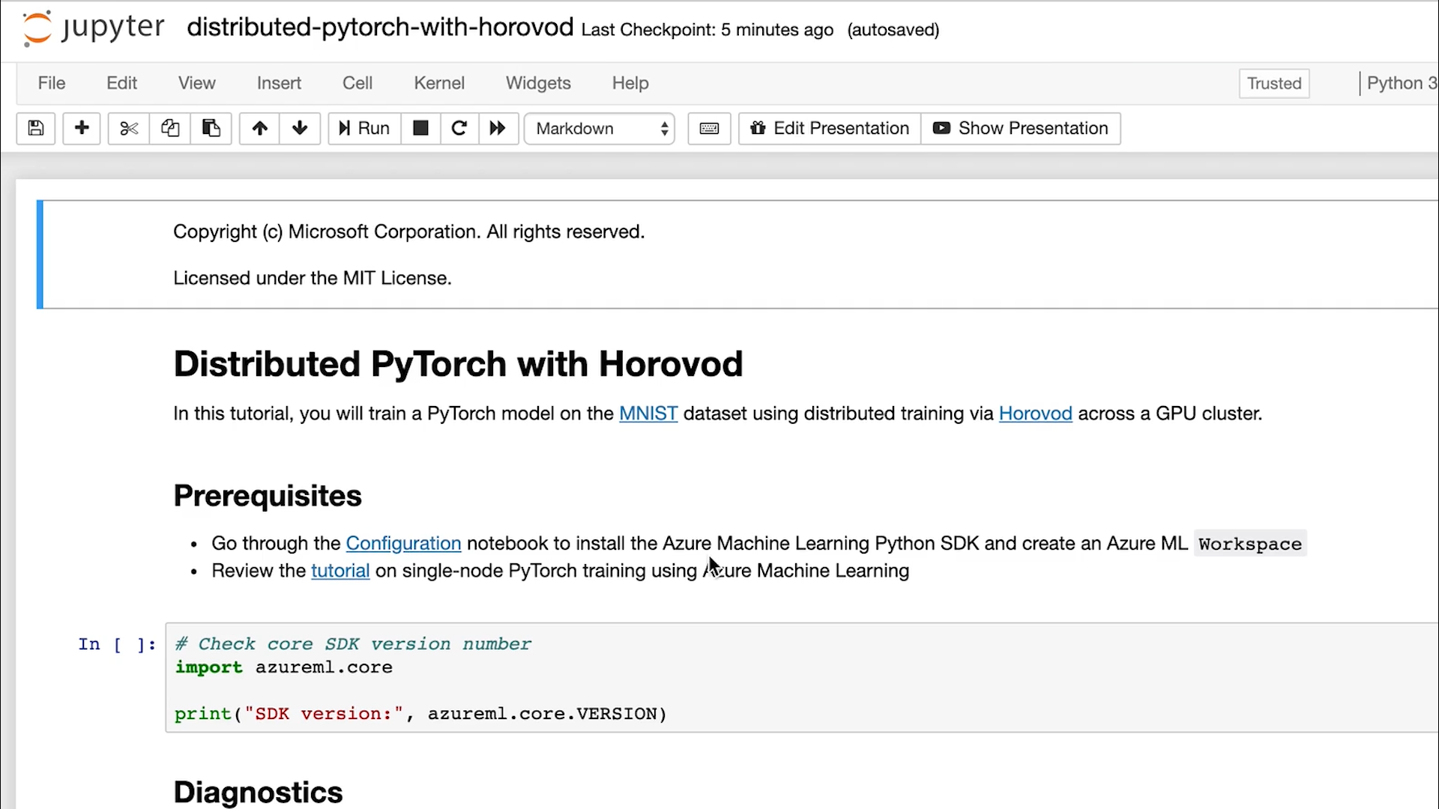
Simplify machine learning for any skill level
Automated machine learning UI
Designer
Machine learning notebooks

Slide 17
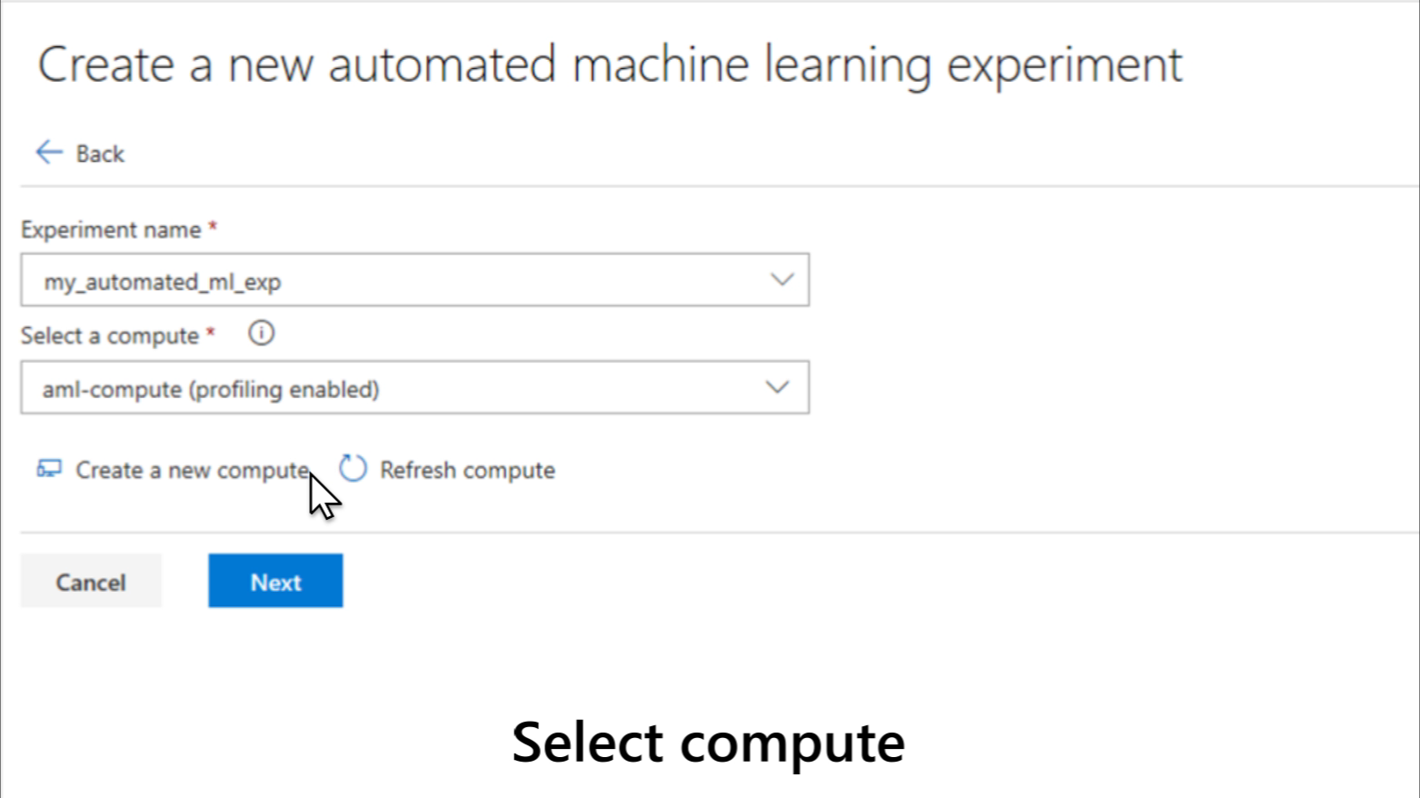
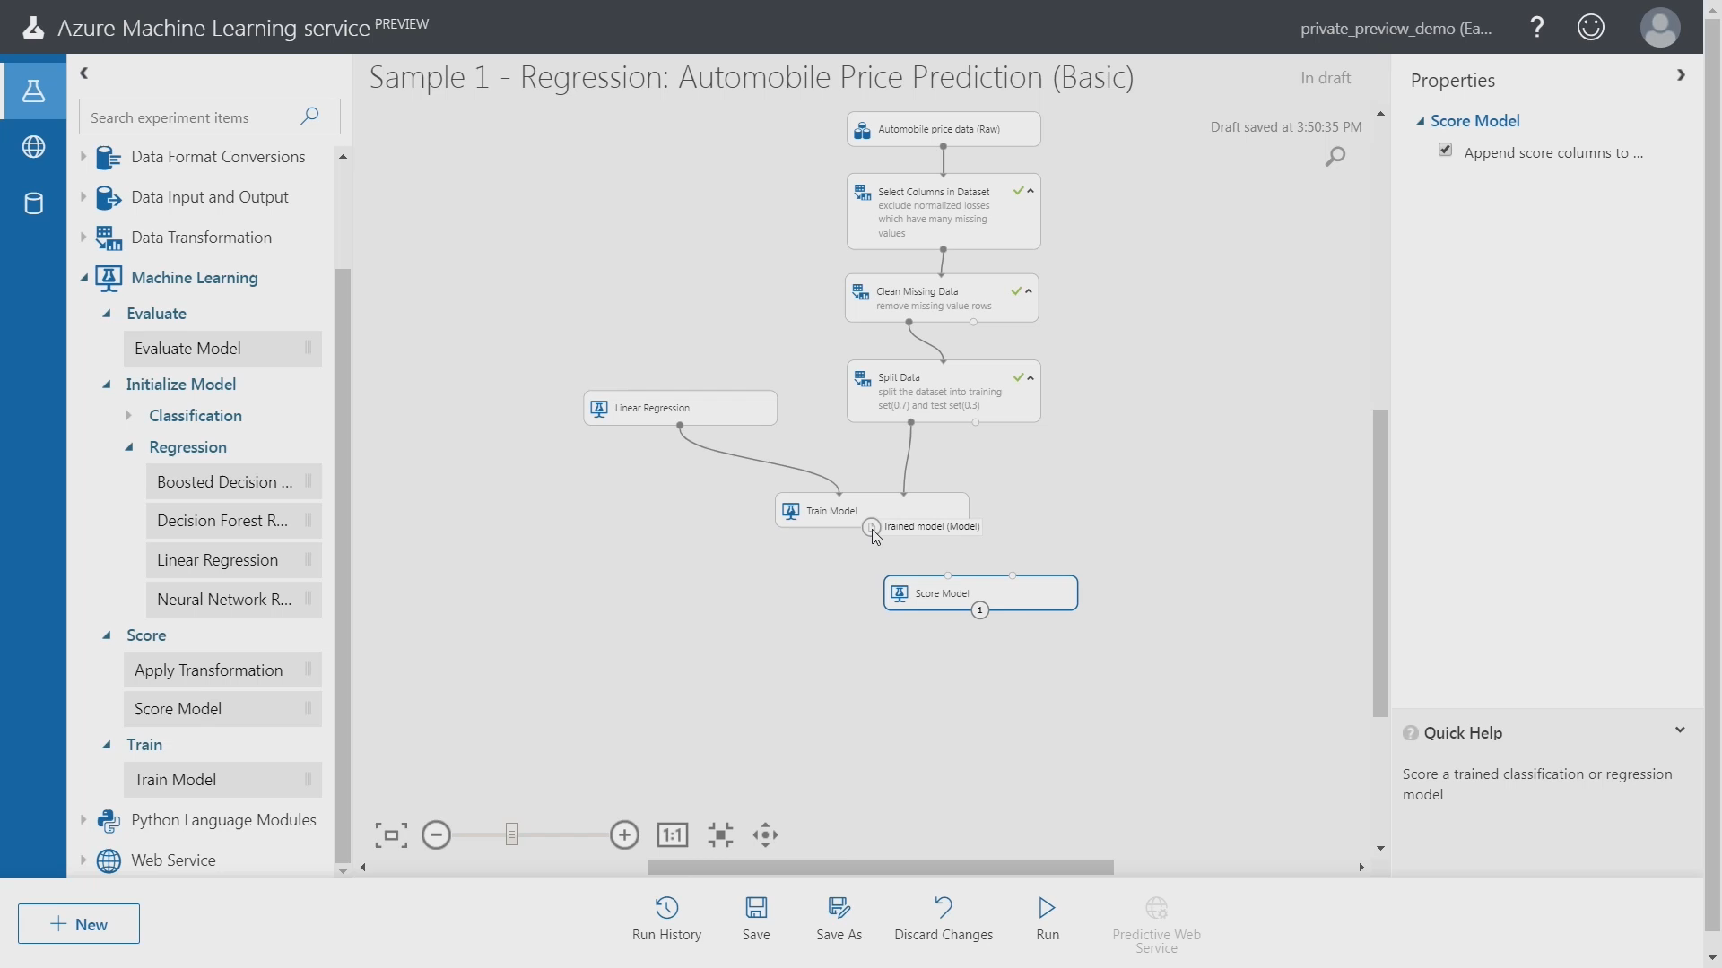
Simplify machine learning for any skill level
Visual interface
Machine learning notebooks
Automated machine learning UI

Slide 18
Azure Machine Learning
Automated machine learning
How much is this car worth?
Notes:
Let say we have a problem of how much is this car worth which we want to solve using machine learning
Our approach to ML frameworks is simple.
We give customers the flexibility to choose their deep learning framework, without getting locked one framework.
To help with this we’ve created a community project in partnership with Facebook that allows customers to train in one framework and use another one for inference
Now, let me move to the ML services on Azure

Slide 19
Model creation is typically a time consuming process
Which features?
Which algorithm?
Which parameters?
Mileage
Condition
Car brand
Year of make
Regulations
…
Gradient Boosted
Nearest Neighbors
SVM
Bayesian Regression
LGBM
…
Parameter 1
Parameter 2
Parameter 3
Parameter 4
…
Mileage
Gradient Boosted
Criterion
Loss
Min Samples Split
Min Samples Leaf
Others
Car brand
Year of make
30%
Model
Notes:
Model creation is a very complex process where one has to experiment with different model architectures and tune hyperparameters to see which gives the best accuracy or performance metrics. You will be experimenting and repeating different combinations to hopefully find the best one. And once you find the best one, it maybe hard to know exactly how to reproduce that one. AML makes it easy for you to reproduce the best model with all the tracking we do for you.
Our approach to ML frameworks is simple.
We give customers the flexibility to choose their deep learning framework, without getting locked one framework.
To help with this we’ve created a community project in partnership with Facebook that allows customers to train in one framework and use another one for inference
Now, let me move to the ML services on Azure

Slide 20
Model creation is typically a time consuming process
Track
Which features?
Which algorithm?
Which parameters?
Mileage
Condition
Car brand
Year of make
Regulations
…
Gradient Boosted
Nearest Neighbors
SGD
Bayesian Regression
LGBM
…
Criterion
Loss
Min Samples Split
Min Samples Leaf
XYZ
Mileage
Gradient Boosted
N Neighbors
Weights
Metric
P
ZYX
Condition
Nearest Neighbors
Car brand
Car brand
50%
Year of make
30%
Year of make
Model
Iterate
Notes:
Our approach to ML frameworks is simple.
We give customers the flexibility to choose their deep learning framework, without getting locked one framework.
To help with this we’ve created a community project in partnership with Facebook that allows customers to train in one framework and use another one for inference
Now, let me move to the ML services on Azure

Slide 21
Model creation is typically a time consuming process
Track
Which features?
Which algorithm?
Which parameters?
30%
50%
70%
30%
45%
50%
65%
95%
35%
10%
75%
20%
70%
30%
15%
Iterate
Notes:
Our approach to ML frameworks is simple.
We give customers the flexibility to choose their deep learning framework, without getting locked one framework.
To help with this we’ve created a community project in partnership with Facebook that allows customers to train in one framework and use another one for inference
Now, let me move to the ML services on Azure

Slide 22
Automated Machine Learning accelerates model development
Input
Intelligently test multiple models in parallel
Output
25%
Optimized model
25%
40%
Enter data
70%
25%
40%
70%
95%
95%
Define goals
25%
40%
70%
25%
40%
25%
70%
Apply constraints
40%
Notes:
AutoML really helps to expedite this process by intelligently does the exploration phase by using machine learning for you. It intelligently tests multiple algorithms for the dataset in parallel using the AML compute that meets your goals and identifies the best model as the output.
This makes machine learning much more accessible for wider audience. Also, even for advanced data scientists, this can be a great tool of exploration to accelerate the model development.
Our approach to ML frameworks is simple.
We give customers the flexibility to choose their deep learning framework, without getting locked one framework.
To help with this we’ve created a community project in partnership with Facebook that allows customers to train in one framework and use another one for inference
Now, let me move to the ML services on Azure

Slide 23

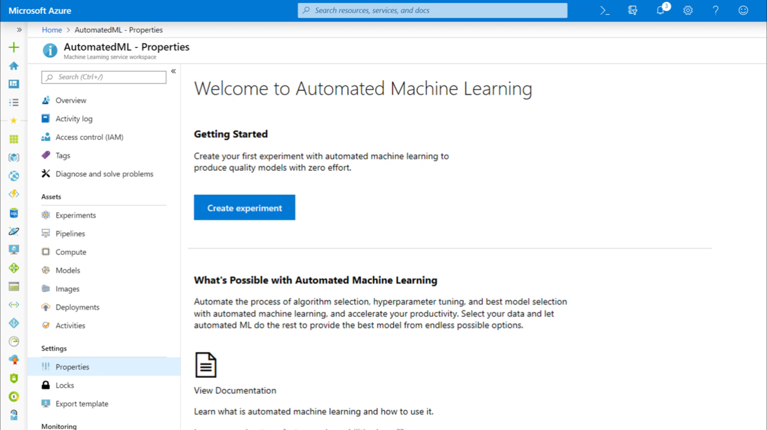
Simplify machine learning for any skill level
Automated machine learning UI
Machine learning notebooks
Designer

Slide 24
Simplify machine learning for any skill level
Automated machine learning UI
Visual interface
Machine learning notebooks

Slide 25
Azure Machine Learning service
End to end lifecycle management

Slide 26
DevOps
MLOps
Code reproducibility
Model reproducibility
Code testing
Model validation
App deployment
Model deployment
Model retraining

Slide 27


MLOps with Azure Machine Learning
Collaborate
Build app
Test app
Release app
Monitor app
App developer
using Azure DevOps
Data scientist using
Azure Machine Learning
Model reproducibility
Model validation
Model deployment
Model retraining

Slide 28


MLOps with Azure Machine Learning
Collaborate
Build app
Test app
Release app
Monitor app
App developer
using Azure DevOps
Code, dataset, and environment versioning
Data scientist using
Azure Machine Learning
Model reproducibility
Model validation
Model deployment
Model retraining

Slide 29
MLOps with Azure Machine Learning
Collaborate
Build app
Test app
Release app
Monitor app
App developer
using Azure DevOps
Train model
Validate model
Model validation & profiling
Data scientist using
Azure Machine Learning
Model reproducibility
Model validation
Model deployment
Model retraining

Slide 30
MLOps with Azure Machine Learning
Collaborate
Build app
Test app
Release app
Monitor app
App developer
using Azure DevOps
Train model
Validate model
Deploy model
Model packaging
Simple deployment across cloud and edge
Data scientist using
Azure Machine Learning
Model reproducibility
Model validation
Model deployment
Model retraining

Slide 31
MLOps with Azure Machine Learning
Collaborate
Build app
Test app
Release app
Monitor app
App developer
using Azure DevOps
Train model
Validate model
Deploy model
Monitor model
Model management & monitoring
Data scientist using
Azure Machine Learning
Retrain model
Model performance analysis
Model reproducibility
Model validation
Model deployment
Model retraining

Slide 32


MLOps with Azure Machine Learning
Collaborate
Build app
Test app
Release app
Monitor app
App developer
using Azure DevOps
Train model
Validate model
Deploy model
Monitor model
Azure Machine Learning extension for Azure DevOps
Data scientist using
Azure Machine Learning
Retrain model
Model reproducibility
Model validation
Model deployment
Model retraining

Slide 33
MLOps with Azure Machine Learning
Collaborate
Build app
Test app
Release app
Monitor app
App developer
using Azure DevOps
Train model
Validate model
Deploy model
Monitor model
Audit trail management and model interpretability
Data scientist using
Azure Machine Learning
Retrain model
Model reproducibility
Model validation
Model deployment
Model retraining

Slide 34
Machine Learning on Azure
Domain specific pretrained models
To simplify solution development
…
Vision
Speech
Language
Search
Familiar data science tools
To simplify model development
Visual Studio Code
Azure Notebooks
Jupyter
Command line
Popular frameworks
To build advanced deep learning solutions
PyTorch
TensorFlow
Scikit-Learn
ONNX
Productive services
To empower data science and development teams
Azure Databricks
Azure Machine Learning
Machine Learning VMs
Powerful infrastructure
To accelerate deep learning
CPU
GPU
FPGA
From the Intelligent Cloud to the Intelligent Edge
Notes:
Completely thought through

Slide 35
Powerful infrastructure Accelerate Deep Learning
CPUs
GPUs
FPGAs
General purpose machine learning
D, F, L, M, H Series
Deep learning
N Series
Specialized hardware accelerated deep learning
AML hardware accelerated models (Project Brainwave)
Optimized for flexibility
Optimized for performance
Notes:
We have the most comprehensive AI infrastructure
From general purpose CPUs to specialized HW (FPGAs)
FPGA -> lowest cost inferencing. Lower than Google’s TPUs
Most comprehensive set of GPU options so customers can choose the right one for their project. (best price/performance)
<Transition> Let me move to the last part of our ML portfolio.

Slide 36




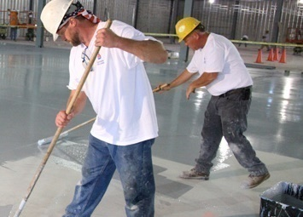


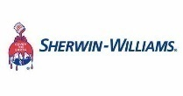
Some transformational scenarios Machine Learning addresses
Product recommendation
Predictive maintenance
Demand forecasting
The average size of a single cart has decreased
Unplanned downtime results in cost overruns
Optimize manufacturing processes and labor hours
Provide personalized digital content to shoppers
Predict when maintenance should be performed
Forecast when processes are complete and manual intervention needed
Increase cart size
Minimize downtime
Optimize operations
Drives down model build times from months to weeks, improves collaboration and the model-building experience for its data scientists and engineers.
Oil and gas customers boost worker safety, minimize maintenance costs, proactively detect dangerous conditions before environmental harm occurs.
Categorize chemical formulas and forecast the output of manufacturing processes, in order to create efficient resource utilization.
Notes:
With machine learning, you can build powerful recommendation engines to delight customers with improved shopping experiences.
The average size of a single cart has decreased as customers spend more money in general, but spend less per retailer.
Recommendation engines powered by machine learning engage customers by providing relevant content, leading to increased cart size.
ASOS built a recommendations platform on Azure that provides personalized experiences to its more than 15 million customers, capable of processing over 33 orders per second.
Customers can also use machine learning on Azure to optimize operations through predictive maintenance.
We all know that equipment failures can lead to cost overruns and unnecessary downtime.
If we anticipate failures and predict when maintenance should be performed, we can prevent disruptions and manage cost.
Carnival Maritime used machine learning on Azure to accomplish exactly that—saving $200k per ship per year by predicting onboard water usage.
Yet another way that our customers are bringing advanced analytics to life is through demand forecasting.
Solar energy is generated by myriad providers with variable production, making it challenging to integrate with traditional power transmission grids.
In order to align solar energy supply with the optimal markets, they need to forecast the weather, expected energy production, and energy values across multiple markets.
Azure provided Renewables.AI the power, scale, and capacity to build a stable and profitable solar energy market.
<Transition>: Let’s take a closer look at how companies like these are achieving these results.

Slide 37
Questions?

